Slide 1
Financial Education & Progress Awareness Campaign

Slide 2
India Struggles for jobs
77% of the population is doing Job
51% Male
26% Female
2022
17%
Of People with Degree - No Job
2021
19%
Of People with Degree - No Job
2020
16%
Of People with Degree - No Job
2019
Only 17% of People work in well organized sector, with good salary
14%
Of People with Degree - No Job

Slide 3
Different Business Models
BUSINESS
CAPITAL
EXPERIENCE EXPENSES
SPACE
STAFF
MAINTENANCE
FRANCHISEE
MONGINIS – 10 LAKHS
YEVALE TEA – 28 LAKHS
KAMATH – 25 LAKHS
JAVED HABIB – 22 LAKHS
KFC – 1 CRORE
MC DONALDS – 5 CRORE
Business
RISK
Franchisee

Slide 4
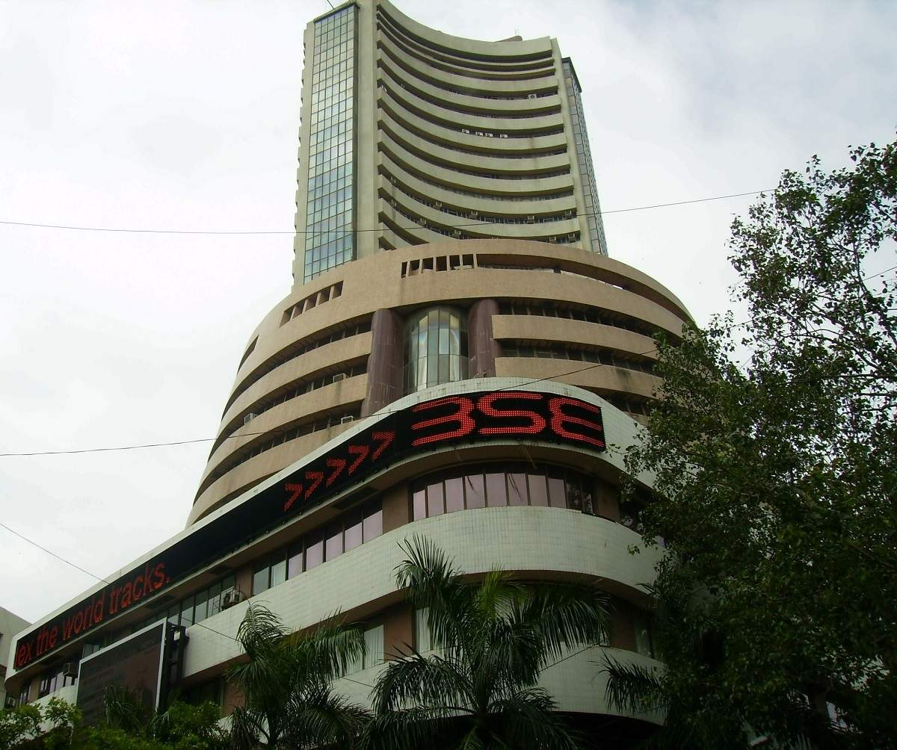
Indian Stock
Market
Indian Forex
Market
Forex Market
(Foreign Exchange)
Currency Trading
34 Billion Dollar / Day
Currency Exchange
8.25 lakh Crore INR / day
Timing : 9:15 AM to 3:30 PM
6.6 Trillion Dollar / Day
Timing : 9:00 AM to 7:30 PM
Timing : 24 x 5

Slide 5
Why Trading / Investing is important ?
Recession and Pandemic Proof Business
Earning based on Knowledge
Passive Source of Income
No Age Barriers
Time Flexibility
Become a Investor

Slide 6
Examples of Great Investment
Company | Year | Share Price | Year | Share Price | Investment | Return
 | 1991 | 0.13 | 2021 | 554.25 | ₹ 10,000 | ₹ 4.2Crore
 | 2002 | 2.25 | 2021 | 2530.25 | ₹ 100,000 | ₹ 11 crore
 | 2004 | 123.44 | 2021 | 3216.5 | ₹ 100,000 | ₹ 26 Lakh
 | 2009 | 1372 | 2022 | 87650 | ₹ 100,000 | ₹ 63.8 Lakh

Slide 7
Inflation - Rises by 5 % Every Year
Annual Minimum Growth in Different Investments with Proper Risk Management
Equity (Stock Market)
Real Estate
Mutual Funds
Gold
Equity ( Stock Market) Growth
Fixed Deposit
Real Estate
Growth
Mutual Funds Growth
Fixed Deposit Growth
Gold Growth
17% /P.A
13% /P.A
12% /P.A
8% /P.A
5% /P.A

Slide 8
Normal Market Fees Structure
Indian Stock Market : 2 Lakhs + Per Year
Forex Market : 6 Lakhs + Per Year

Slide 9
Our Online Education System
MONDAY TO FRIDAY > LIVE SESSIONS > 9PM ONWARDS
SATURDAY > MENTORING SESSIONS > 4PM ONWARDS.
All sessions are live and interactive
Recorded sessions for revision on App.
Expert Mentoring
Live Doubt clearing sessions
Trading Support group
Mind training for trading

Slide 11
Awards and recognition
DPIAF
(DADASAHEB PHALKE ICON AWARDS FILM)2020
Best Online Financial Education Provider in India
DSBA
(DIRECT SELLING AND BUSINESS AWARD)2021
Best Startup of the YEAR 2020-2021 in Direct Selling Industry and Best Business Award
Dr. NELSON MANDELLA NOBEL PEACE AWARD 2020
Noble and Excellent Contribution towards Society through Financial Education and Atmanirbhar Bharat
DOCTORATE FROM AMERICAN UNIVERSITY
CMD, Dr. Bajirao Kolekar has been graced with Degree of Doctorate of Philosophy (Specialization in Online Education System )
ISO 21001:2018
Certificate received for developing, maintaining and continuously improving business processes and comparing
business performance to appropriate quality standards.
Recognized as a “Start-up” by the “Department for promotions of
Industries and Internal Trade, Govt. of India”.
Gopa DasGupta has been honored as the Best CEO of 2023 by Direct Selling Today.
CEO Gopa DasGupta has been acclaimed with the distinguished Maharashtra Ratna Puraskar in 2023.
Global Head Mr. Vinod Shedge Awarded with Entrepreneur of the year and Business Icon award in 2023

Slide 12
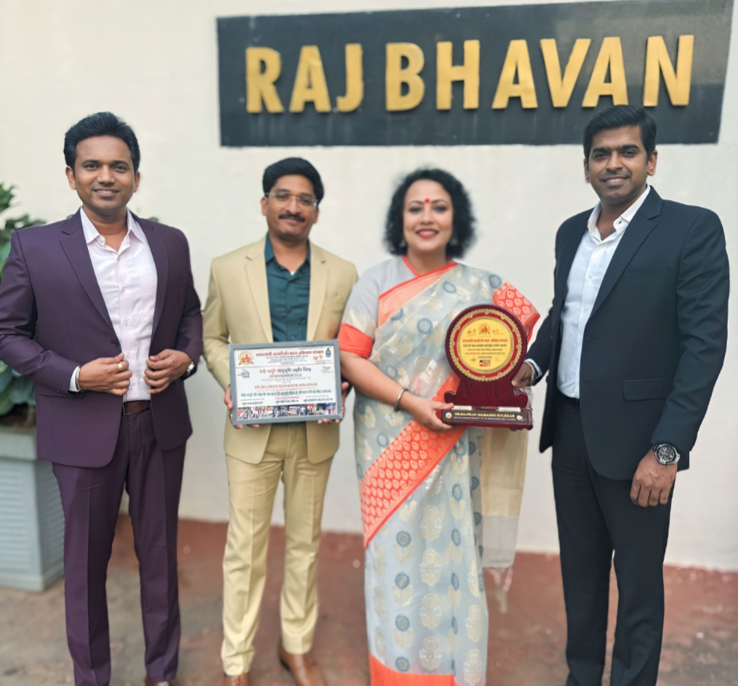
Awards and recognition
CMD DR. BAJIRAO KOLEKAR HAS BEEN BESTOWED WITH THE
PRESTIGIOUS EXCELLENCE IN SKILL BUILDING AWARD BY THE ESTEEMED
GOVERNOR OF MAHARASHTRA, SHRI RAMESH BAIS.

Slide 13
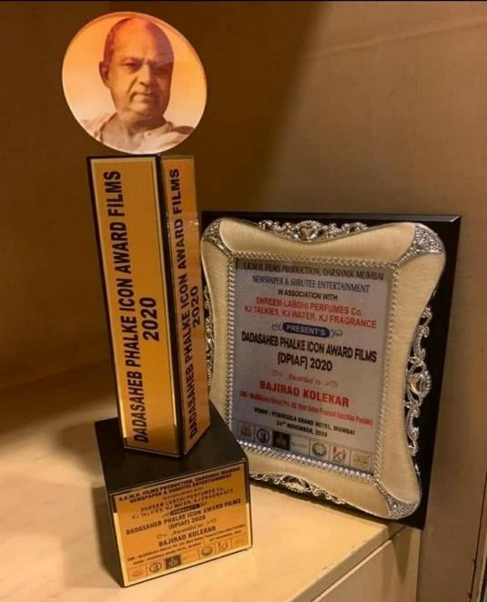
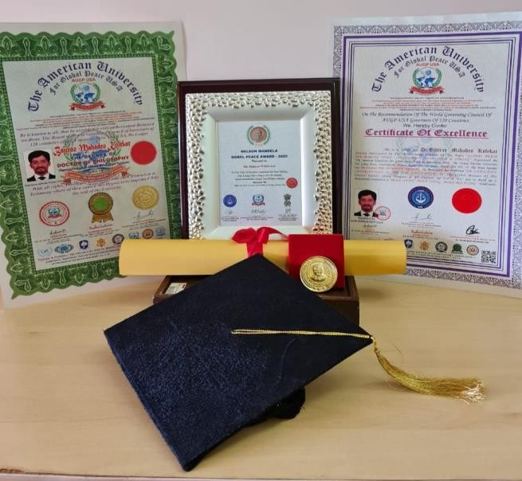
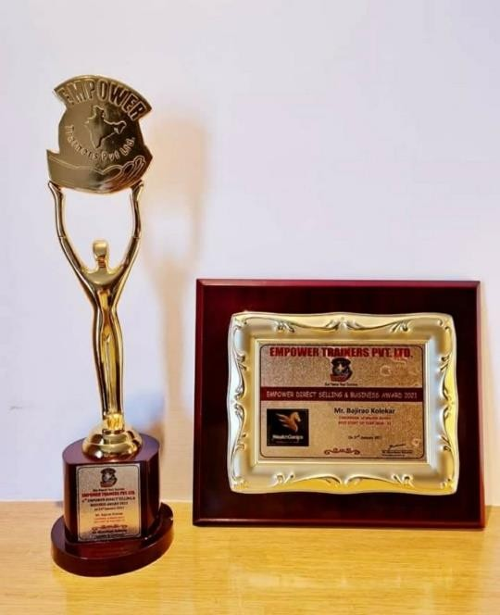
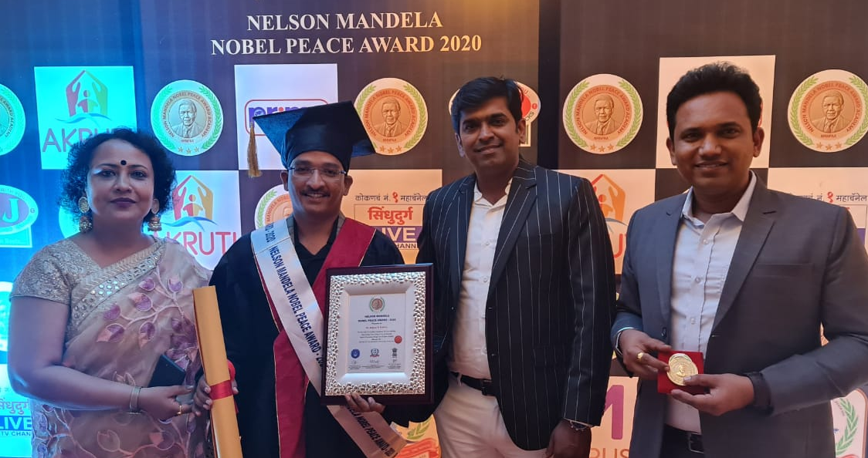
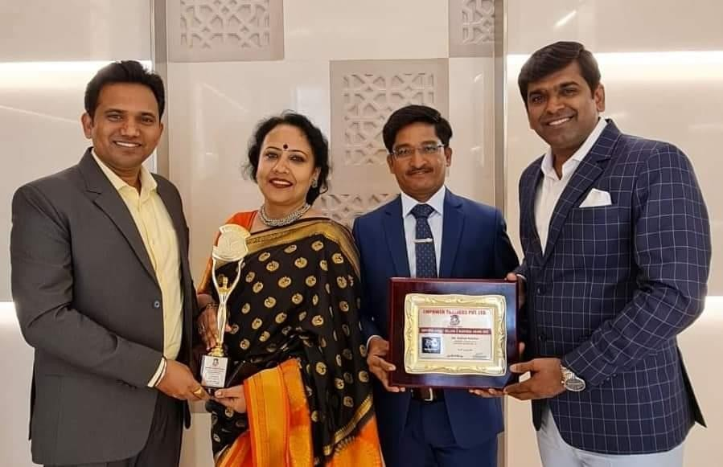
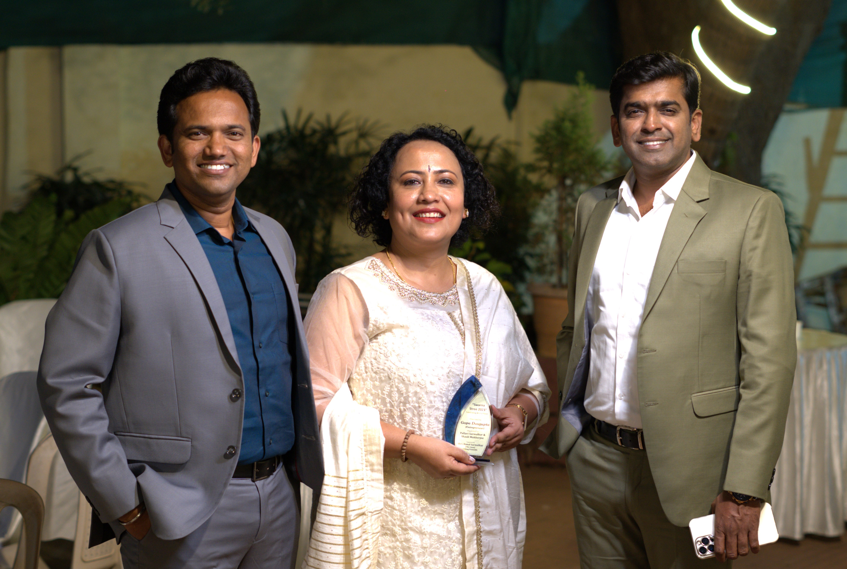
Awards and Recognition

Slide 14
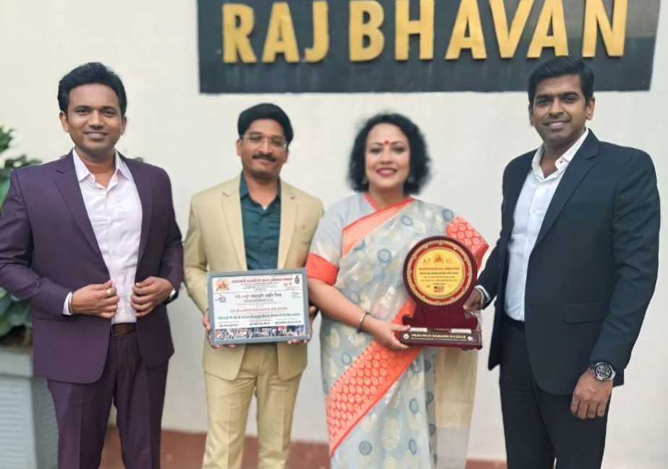
Awards and Recognition

Slide 15
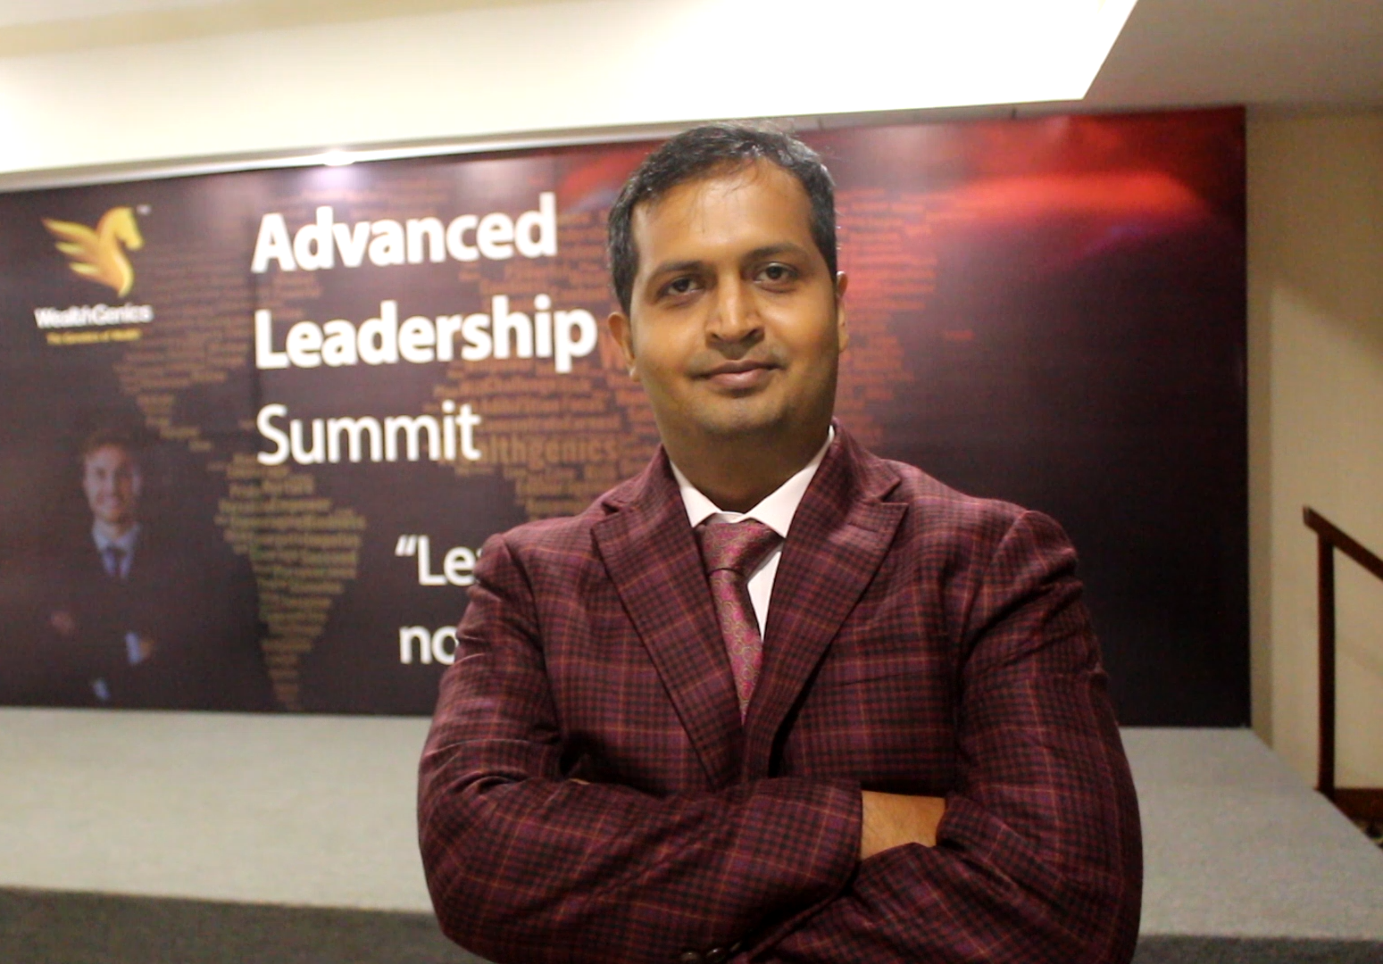
Our Superstar
Dr. Manthan Pandya
It's impossible not to be a fan of him if you have learned from him.

Slide 16
How we help you ?
DOWNLOAD OUR APPLICATION

Slide 17
What About other Family Members
What we have for them ?
We are on a Mission
आत्मनिर्भर भारत
हर घर में एक ट्रेडर TM
हर घर में एक इंटरप्रेनर TM
हर परिवार प्रगतिशील परिवार TM
Don’t worry
We Got your back
Let's Deep Dive In

Slide 18
WHAT ABOUT OTHER FAMILY MEMBERS
WHAT WE HAVE FOR THEM ?
Don’t worry
We Got your back
Let's Deep Dive In

Slide 19
Wealth
WealthGenics cares about every need of your Family. We care both about your Health, Wealth and Over-all Wellbeing.
Q
Health

Slide 20
0
Financial Education Stock / Forex market
Global market access
Currency trading skills
Potential for profit
Hedging strategies
Geopolitical insights
24/5 trading flexibility
Risk management tools
Diversification options
Enhanced financial knowledge
Expanding investment horizons
01
02
03

Slide 21
02
Tech Analyzing
Donec ornare rutrum neque sit amet pellentesque. Nulla eget dictum tortor.
g
Memory Enhancement Program
Fast Track Your Career.
Become Smart Student By Acquiring Scientific Study Methods
Be Stress Free & More Confident During Exam
Memorize Every Answer 10 Times Faster With 100% Retention
Memorize The Whole Book Effortlessly In Movie Format
Emerge As A Winner With Memory Skills In This Hyper-competitive World
02
05

Slide 22
01
Financial Planning & Wealth Management
Meeting Financial Goals
Prepare for unexpected Financial Event
Peace & satisfaction about your financial situation
Offers Security for Your Family.
Helps You Prepare for Retirement.
Provides Flexible Investment Strategy
03
03

Slide 23
01
Start Here
Donec ornare rutrum neque sit amet pellentesque. Nulla eget dictum tortor.
Personality Development
04
Supports a Healthy Work Culture
Increases self-awareness
Boosts the confidence
Help to achieve the life goals
04

Slide 24
05
Finish Process
Donec ornare rutrum neque sit amet pellentesque. Nulla eget dictum tortor.
D
Spoken English And Communication
Improved communication skills
Enhanced career opportunities
Access to global information
Increased travel options
Cultural enrichment
Improved academic opportunities
Enhanced problem-solving skills
05
08

Slide 25
01
Start Here
Donec ornare rutrum neque sit amet pellentesque. Nulla eget dictum tortor.
Public Speaking &
Communication Skill
06
You Will Enjoy Your Work
You Can Be An Influencer
You Will Get Lots Of Love & Respect From People
You Will Get Dignified Recognition
04

Slide 26
04
Test Process
Donec ornare rutrum neque sit amet pellentesque. Nulla eget dictum tortor.
d
Heal Yourself with Diet
Weight Management
PCOS
Pediatric Diets
Diabetes Mellitus
Cardiac Diets
Gut Health Diet
Balance Food Diet
Pregnancy Diets
Cancer Diet
07
07

Slide 27
03
Creation Process
Donec ornare rutrum neque sit amet pellentesque. Nulla eget dictum tortor.
s
Yoga: Mind-Body Harmony.
Physical fitness
Stress reduction
Improved posture
Increased energy
Mental clarity
Better sleep
Flexibility and balance
Cardiovascular health
Weight management
Overall well-being
08
06

Slide 28
05
Finish Process
Donec ornare rutrum neque sit amet pellentesque. Nulla eget dictum tortor.
D
Zumba-Energizing Dance Workout
Cardiovascular Fitness
Weight Loss
Improved Coordination
Mood Enhancement
Increased Endurance
Full-Body Toning
Stress Relief
Enhanced Flexibility
Social Engagement
Fun and Enjoyment
09
08

Slide 29
06
Option Six
Donec ornare rutrum neque sit amet pellentesque. Nulla eget dictum tortor.
Dance - Expressive Movement Art
Physical Fitness
Improved Balance and Coordination
Increased Flexibility
Enhanced Posture and Alignment
Boosted Mood and Self-Confidence
Stress Relief
Cognitive Enhancement
Social Interaction and Connection
Creative Expression
Cultural Appreciation
10

Slide 30
All This will Cost You Approx
₹ 3,00,000
Per Annum

Slide 31
Our Fees Structure
SMART : 25000+(18% GST)
12 Months Subscription with All Benefit
Additional Benefits
Live Interactive Sessions – 9 To 10 PM
App Education (12 Modules)
240 Live Session
Special Extra Session (Mind Mentoring)
WG Traders Community

Slide 32
Our Fees Structure
SKILL BOOST : 17,500+(18% GST)
12 Months Subscription
Additional Benefits
Live Interactive Sessions – 9 To 10 PM
App Education (12 Modules)
Financial Education
Financial Planning And Wealth Management
Memory Enhancement Training
Spoken English

Slide 33
Our Fees Structure
SMART STUDY : 10000+(18% GST)
12 Months Subscription
Live Interactive Sessions – 9 To 10 PM
App Education (12 Modules)
Financial Education
Financial Planning And Wealth Management
Memory Enhancement Training

Slide 34
Why we are Unique?
Scholarship :
1st rank – Rs.25000
2nd rank – Rs.15000
3rd rank – Rs. 10000 4th & 5th rank – Rs.7500 each.
Ultimate Convenience: Everything Under One Roof
5 Days Money Back Guarantee

Slide 35
Sample Certificates
Course Completion Certificate
Scholarship Certificate

Slide 36
DISCLAIMER
At WEALTHGENICS EDUCART PRIVATE LIMITED, we offer financial education and live technical analysis to subscribers, focusing solely on knowledge. We don't engage in fund management or investment. Trading decisions are at your own risk. We strictly oppose illegal activities and don't accept responsibility for investment decisions made by subscribers.

Slide 37
BANK TRANSFER OR GOOGLE PAY TO ENROLL :
WEALTHGENICS EDUCART PVT LTD
Bank - ICICI Bank
A/C No : 148705000560 IFSC: ICIC0001487 BRANCH: THANE KOPRI
9321280622 Googlepay
Payment Gateway Available (CCAvenue)

